Slide 1
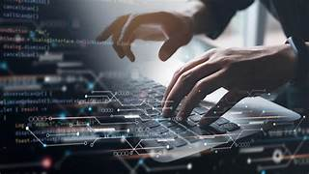
The IT Industry: Trends and Future Outlook

Slide 2
Introduction
refers to the use of computers, storage, networking devices, and other
physical devices, infrastructure, and processes to create, process, store,
secure, and exchange all forms of electronic data. IT encompasses a variety
of technologies that are used for managing and processing information, often
in the context of a business or other enterprise. It involves both hardware and
software components and includes everything from the physical aspects of
computing to the intricate details of software applications and database management.

Slide 3
Examples of Information Technology in Use
Business: Enterprise Resource Planning (ERP) systems, Customer Relationship Management (CRM) software.
Healthcare: Electronic Health Records (EHR), telemedicine platforms.
Education: Learning Management Systems (LMS), virtual classrooms.
Finance: Online banking, mobile payment systems.
Entertainment: Streaming services, online gaming platforms.

Slide 4
Historical Background of the IT Industry
1940s: The Birth of Modern Computing
1960s: Mainframes and Minicomputers
1970s: The Microprocessor Revolution
1980s: The Rise of the PC
1990s: The Internet and Networking Boom
2000s: Mobility and Cloud Computing
2010s-Present: Big Data, AI, and Emerging Technologies

Slide 5
Current Trends in the IT Industry
Artificial Intelligence and Machine Learning
Cloud Computing
Cybersecurity
Internet of Things (IoT)
Big Data and Analytics

Slide 6
Impact of IT on Other Industries
Healthcare (telemedicine, health records)
Education (e-learning, virtual classrooms)
Finance (FinTech, digital banking)
Manufacturing (automation, Industry 4.0)

Slide 7
Future Outlook
Growth projections for AI and automation
Expansion of 5G networks
Advances in quantum computing
Potential for increased remote work and digital transformation

